Slide 1
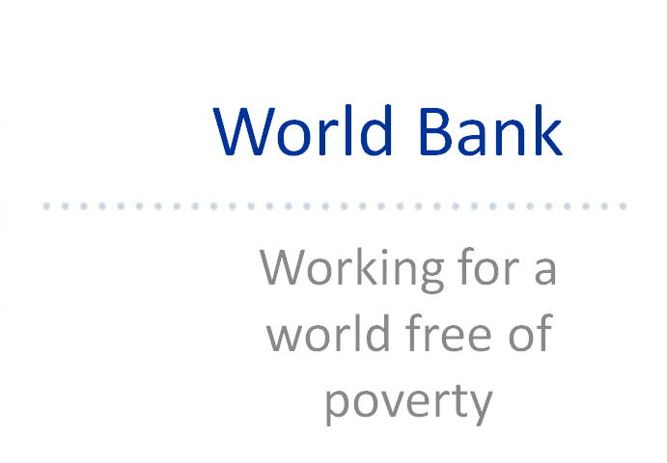

Slide 2
The World Bank Today
Decentralization
14.000+ staff: 60% @ HQ (Washington, DC) and 40% in the field (120 resident missions & 10 satellite offices).
Diversity
187 member countries. 165 nationalities. 140 languages.
Dec. 2012: gender parity @ the managerial level.
55% staff from developing countries.

Slide 3
The World Bank’s Role in Development
A Development Finance Institution:
- The largest provider of development assistance through varied instruments
A Global Partner:
- Secures poverty reduction & sustainable growth in partnership - catalyzes investments & works with Govts, NGOs, Private Sector, Bilaterals, Multilaterals
A Knowledge Bank:
- Provides technical assistance from its global knowledge and diverse pool of skills

Slide 4
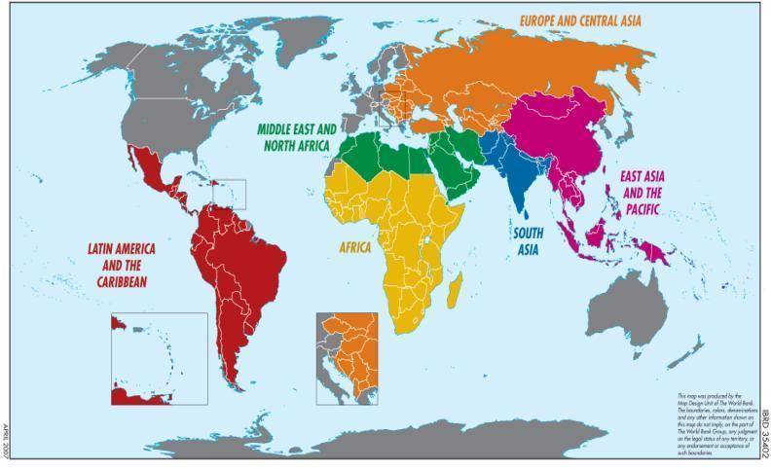
Where Does the Bank Work?
Notes:
“The World According to the WB” – 6 Regions

Slide 5
Thematic Focus of our Work
Human Development Network
Health, Nutrition & Population
Sustainable Development Network
Agriculture & Rural Development
Poverty Reduction & Economic Mgmt Network
Poverty Reduction
Finance and Private Sector Development Network
Financial Sector
Education
Social Protection
Environment
Social Development
Energy & Mining
Water & Sanitation
Transport
Urban Development
Economic Policy
Public Sector Governance
Gender & Development
Private Sector Development
IFC – International Finance Corporation

Slide 6
Current and Upcoming Needs
Climate Change
Disaster Management (Fragile & Conflict States)
Food Crisis
Infrastructure (Fragile & Conflict States)
Health Systems
Renewable Energy
Public Sector Reform (Fragile & Conflict States)
Water Resources Management (Fragile & Conflict States)

Slide 7
World Bank Recruitment
Competitive process for experienced professionals in their mid-career:
worldbank.org
Consulting Opportunities:
networking
For young and motivated individuals:
CAREER: Young Professionals Program (YPP)
EXPOSURE: Junior Professional Associates (JPA)
TRAINING: Bank Internship Program (BIP)

Slide 10
YOUNG PROFESSIONALS PROGRAM
A unique opportunity for a CAREER in leadership and development through the World Bank
Passion and Commitment to Development
Relevant Academic Credentials
Relevant Professional Experience
Excellent Client Engagement and Team Leadership Skills
Ability to Work in a Multi-Sector Manner
International Development Exposure
Additional Language Skills
Applications: May 1 – Jun 30
TO BE ELIGIBLE:
Have relevant graduate degree
Be 32 years of age or younger when entering the YP Program in September 2013 (born on or after September 30, 1980)
Have at least three years of relevant professional and policy-level experience
Be fully proficient in one or more of the additional languages: Arabic, Chinese, French, Portuguese, Russian and/or Spanish
Be fluent in English

Slide 11
Technical Breadth
Client Engagement
& Team Skills
Technical Depth

Slide 12
Stay Connected: Hvala!

